Slide 1


Similes for Love and Relationships
Understanding Figurative Language

Slide 2
What Is a Simile?
A simile compares two unlike things using “like” or “as”.
Similes help readers imagine feelings or relationships by painting a picture.
Example: “He’s as loyal as a dog.”
Similes differ from metaphors because metaphors compare directly without “like” or “as”.
Simile:
Love is like glue.
Metaphor:
Love is glue.

Slide 3



Why Use Similes to Describe Love?
Make feelings easier to imagine
Similes paint pictures that help us feel emotions clearly.
Add personality to writing and speech
They make language colourful and lively.
Create shared emotional images
People relate to familiar comparisons and feel connected.
Feelings
Creativity
Connection

Slide 4

Romantic Similes
As deep as the ocean
Unending love and devotion.
Example: Their love is as deep as the ocean.
Like a flame that never dies
Passionate love that keeps burning.
Example: My passion for you is like a flame that never dies.
Like two puzzle pieces
Perfectly matched and meant to fit together.
Example: They fit together like two puzzle pieces.
[6]

Slide 5

Emotional Similes
Like a warm hug
Comforting and safe.
Example: Her encouragement felt like a warm hug.
Like sunshine on a rainy day
Bright joy that lifts your spirits.
Example: His smile was like sunshine on a rainy day.
As strong as an oak
Dependable and steadfast love.
Example: Their friendship is as strong as an oak.
[7][8]

Slide 6
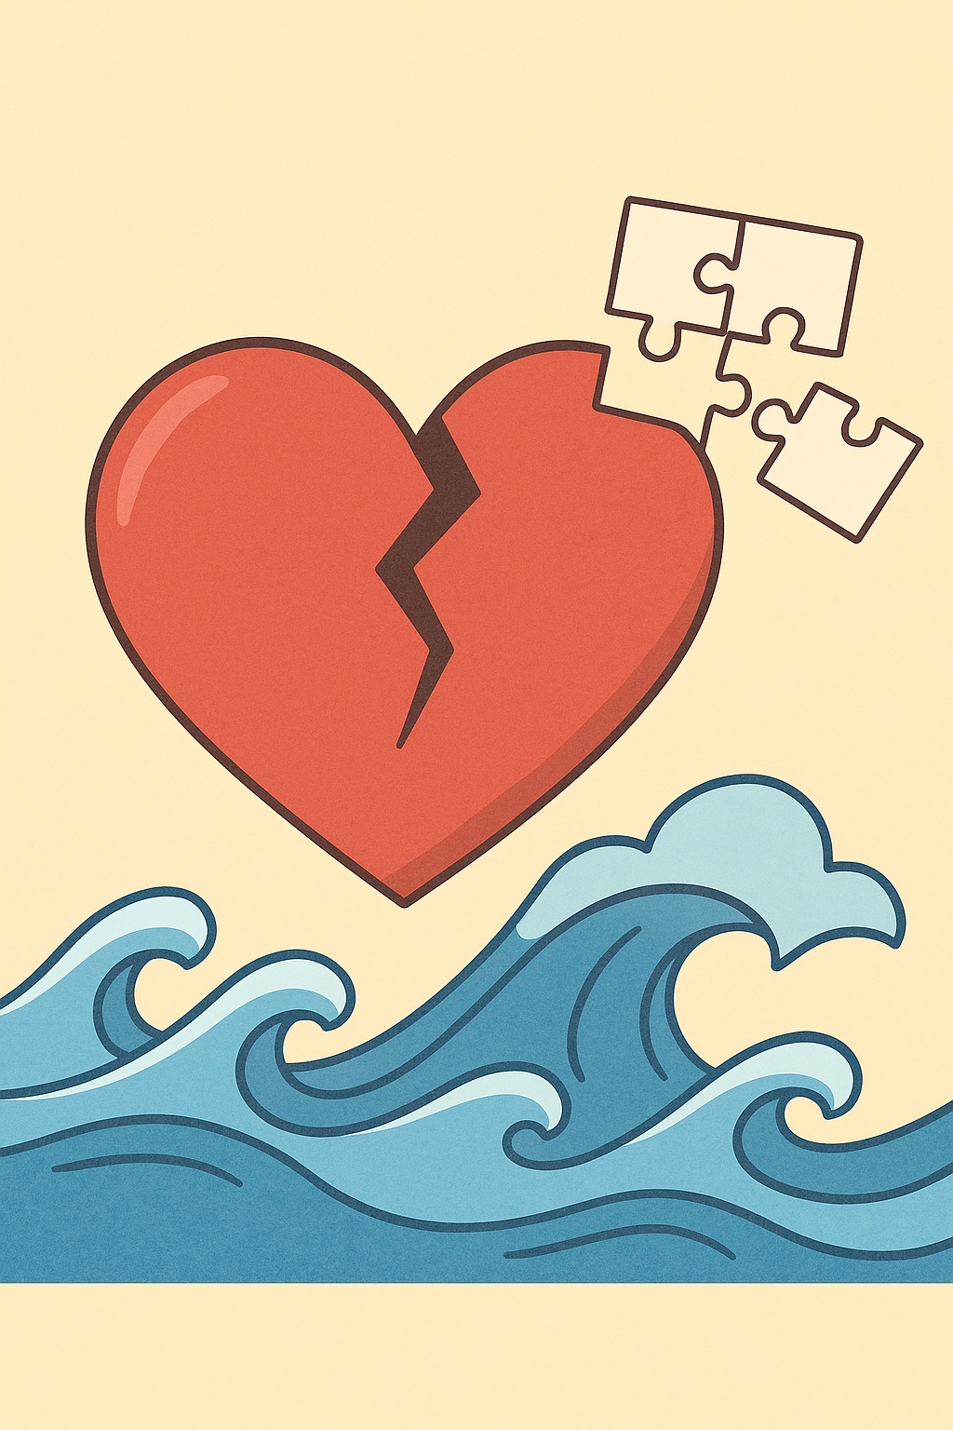
Fragile or Complicated Relationships
Like a roller coaster
Ups and downs of a relationship.
Example: Our friendship has been like a roller coaster lately.
As fragile as glass
Delicate and easily broken.
Example: Trust is as fragile as glass — handle with care.
Like a storm at sea
Turbulent and unpredictable.
Example: Their arguments are like a storm at sea.
[9]

Slide 7

Funny or Playful Similes
As sweet as honey
Describes someone delightfully sweet.
Example: Her kindness is as sweet as honey.
Like glue
So close you can’t be pulled apart.
Example: The twins are like glue — always together.
Snug as a bug in a rug
Comfy and cozy together.
Example: They sat on the couch snug as a bug in a rug.
[10]

Slide 8

Practice: What Does This Simile Mean?
• “Like a roller coaster” – Is it literal or figurative? What feeling does it evoke?
• “As sweet as honey” – What does this say about the person?
• “Like glue” – What kind of relationship does this describe?
[11][12][13]

Slide 9

Create Your Own Love Simile
Think of something sticky, warm, or emotional.
Example: “Love is like a dog waiting by the door.”
Now write your own simile in the space below and share it with a classmate!
[14]

Slide 10
Recap & Takeaways
• A simile uses “like” or “as” to compare unlike things.
• Romantic similes express deep, passionate love.
• Emotional similes convey comfort, joy and strength.
• Fragile similes describe ups, downs and delicate feelings.
• Playful similes add humor and warmth to relationships.
Keep an eye out for similes in books, songs and real life — and try writing one in your journal tonight!

